Slide 1
Weight and balance for the blank l-23

Slide 2
Topics
W&B Concept
Datum Plane
Practice-Excel Method
Practice-Blanik Method

Slide 3
W&B Concept
Datum “zero point”
Negative “Arm”
Positive “Arm”
C.G.
Weight
A moment is defined as a weight times an arm. The Center of Gravity is defined as the sum of all the moments divided by the sum of all the weights. The C.G. is a position relative to the datum.
ALL arms must be measured in the same units (e.g. inches) and from the same datum. Datum can be anywhere on the glider.

Slide 4
Example
2
1
Board: Length = 48 inches, weight= 20 lbs, uniform and centered on the datum
Weight 1: 10 lbs, located 20-inches right of the datum
Weight 2: 15 lbs, located 20-inches left of the datum
Moments: MomentB (the board): 20 lbs time 0 inches (since it’s centered on the datum)= 0 in*lbs
Moment1: 10 lbs * 20 inches = 200 in*lbs
Moment2: 15 lbs * -20 inches = -300 in*lbs (minus because it’s left of the datum)
Total moment = 0 in*lbs + 200 in*lbs - 300 in* lbs =-100 in * lbs
C.G. = Total moment divided by total weight = -100 in*lbs divided by 45 lbs = -2.2 inches
So, the center of gravity is located 2.2 inches LEFT of the datum (i.e. 2.2 inches left of center)

Slide 5
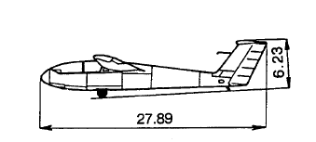
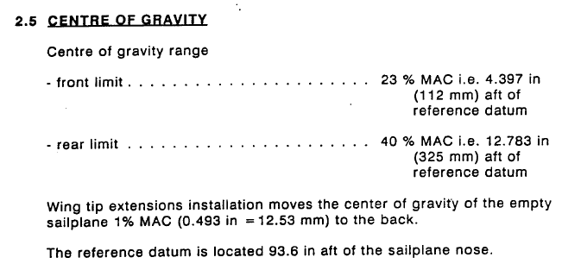
From the Blanik Manual (5ST)

Slide 6
Mean Aerodynamic Chord (MAC)
Chord
Leading Edge
Trailing Edge
The average distance (along the wing) between the leading edge and the trailing edge of the wing is defined as the MAC
From Section 1.4 of the Blanik manual:
4.11 feet is 49.32 inches.

Slide 7
Location of the Blanik Datum
Datum
93.6 in.
The datum is located 93.6 inches from the nose, or 6.95 inches aft of the leading edge
6.9 in

Slide 8
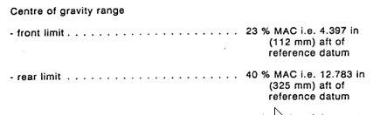
Acceptable C.G. Range
23% MAC = 0.23 * 49.3 in,
or 11.3 in. aft of LE
40% MAC= 0.4 * 49.3 in,
or 19.7 in. aft of LE
4.4 in
8.4 in
6.9 in
Empty Weight C.G. (67.7% MAC)
Forward CG Limit
(23% MAC)
Aft CG Limit
(40% MAC)
Since all the seats are forward of the empty weight C.G., loading moves the C.G. forward, hopefully into the acceptable range

Slide 9
Excel Background
The Excel spreadsheet is NOT official, and should not be used for flight planning
The front and rear seat arms were calculated from the tables and are approximate
The empty weight and empty moment are from W&B prepared by A&P on 6/14/08
This W&B information is specific to 5ST, however, with appropriate changes to empty weight and moment it should be valid for all our Blaniks

Slide 10
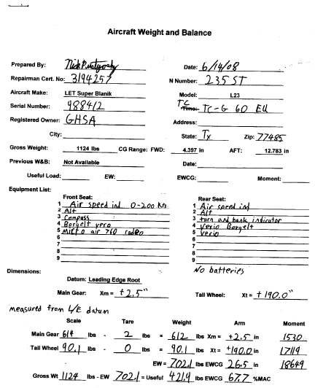
W&B Record by A&P Mechanic:

Slide 11
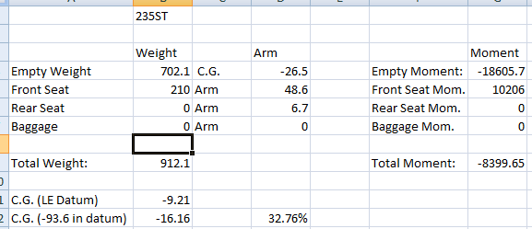
Excel Example
Pilot weight 210 lbs, solo from Front Seat (arm 48.6 inches). Total weight is 912.1 lbs (702.1 empty plus 210 for pilot). Total moment is -8399.65 in*lbs (empty moment plus pilot moment). Total moment divided by total weight is -9.21 inches (aft of the datum point). This is 16.16 inches aft of the leading edge, or 32.76% MAC (16.16/49.32= 0.3276).
The acceptable CG range is from 23% to 40%, so we’re just aft of the center of the CG range.

Slide 12
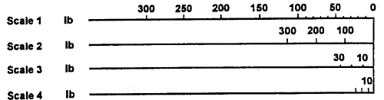
Example: From THE BOOK
Step 1: Find 210 lbs on scale 1:
Step 2: Use a ruler to measure the distance from 0 to 210 lbs on Scale 1, or
Photocopy scale 1 and use it as a ruler
Step 3: Use the scale below to measure from the empty C.G. Position (67.7% MAC) to 210 lbs on line 1.

Slide 13
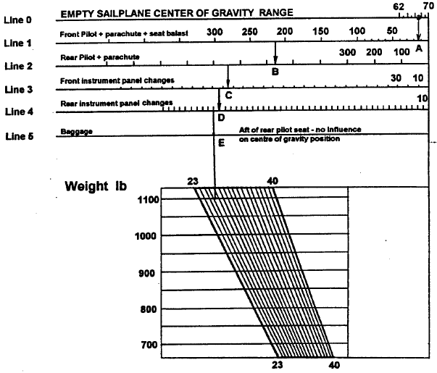
Example, P.2
Step 4: Once you’ve found the point on Line 1, draw a vertical line to the total weight (210 lbs + 702 lbs = 912 lbs)

Slide 14
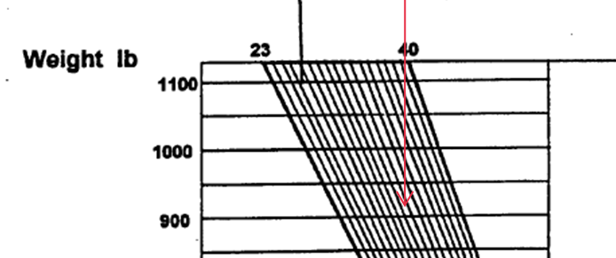
Example, P.3
Blow up of previous graph:
C.G. Location is 32.7% MAC

Slide 15
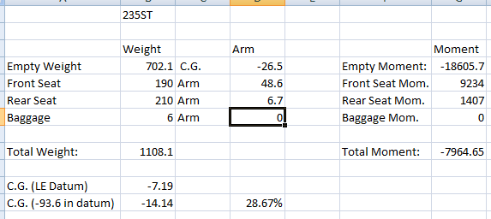
“Book” example 2: 2 people + Batt
Assumptions:
Pilot (rear seat): 210 lbs
Passenger (front seat): 190lbs
Battery: 6 lbs
C.G. is 28.7% MAC (7.2 inches aft of the Leading Edge)

Slide 16
Steps
Step 1- Line 0: Determine the empty C.G. Position (67.7% MAC for 5ST) and draw a vertical line from this position down to Line 1.
Step 2- Line 1: Measure 190 lbs using Scale 1, starting at the vertical line from Step 1.
Step 2- Draw a vertical line down to Line 2
Step 3- From this vertical line, measure 210 lbs on line 2, using Scale 2
Step 4-Draw a vertical line all the way to 1108 lbs
Step 4- Read C.G. position at intersection of vertical line and horizontal 1108 lb line

Slide 17
Book Example 2
Start at 67.7% MAC
190 lbs –scale 1
210 lbs –scale 2
1108 lbs

Slide 18
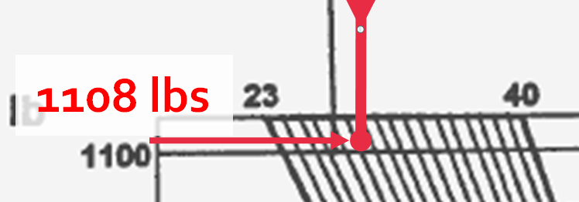
Magnified View
C.G. position is 28.7% MAC

Slide 19
Common Errors
Using wrong scale for front and back seat passengers. Front seat uses scale 1, rear seat uses scale 2.
Not starting measurement from the empty C.G. location (67.7% MAC)
Not extending vertical line all the way down to total weight
Not including battery, baggage (no effect on moment, but increase in total weight)
Not ensuring total load is less than maximum 1124 lbs

